Slide 1




COURCE NAME : DATA SCIENCE AND FUNDAMENTALS
PROCECT TITLE : BITCOIN PRICE PREDICTION
PROJECT SUBMITTED TO : ANNA UNIVERSITY / NAN MUDHALVAN / IBM
YEAR : 3rd Year
BRANCH / DEPARTMENT : BE.MECHANICAL ENGINEERING
SEMESTER : 6th semester
PROJECT SUBMITTED BY : M. SUNDHAR

Slide 2
Bitcoin price prediction

Slide 3


Slide 4
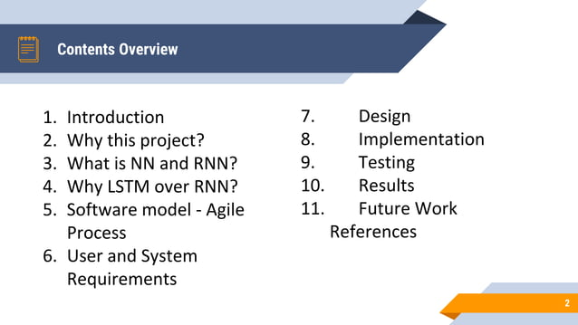

Slide 5
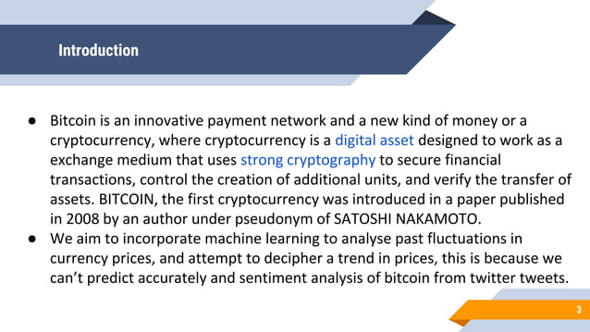

Slide 6


Slide 7
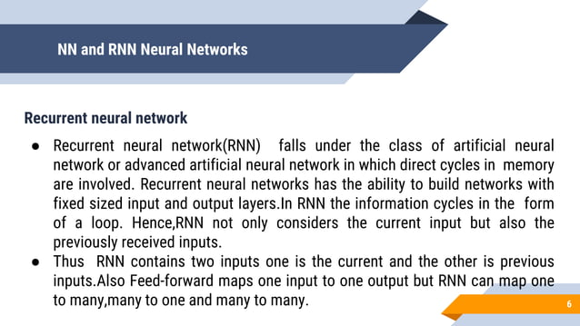

Slide 8
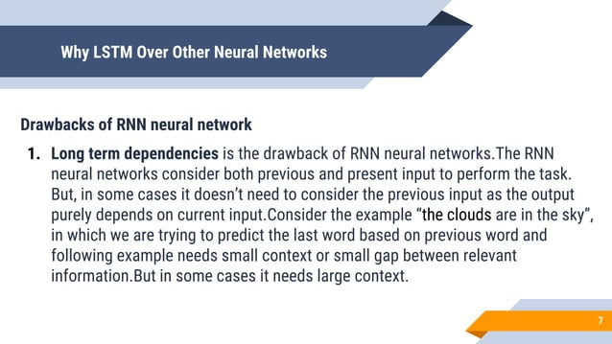

Slide 9
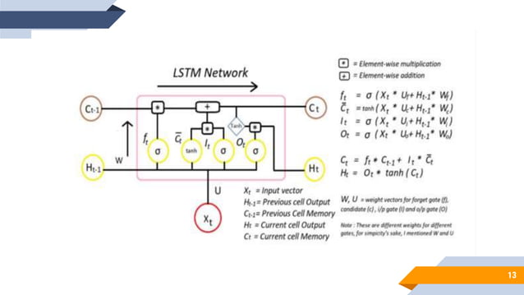

Slide 10
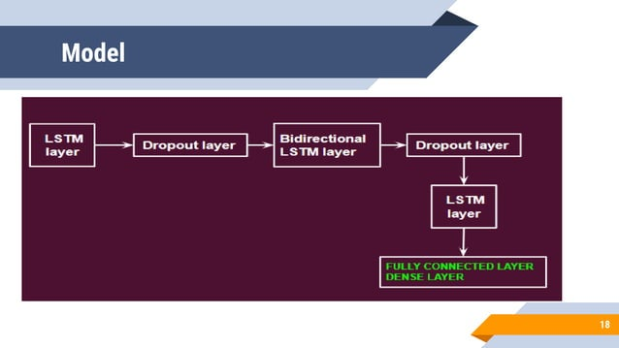

Slide 11
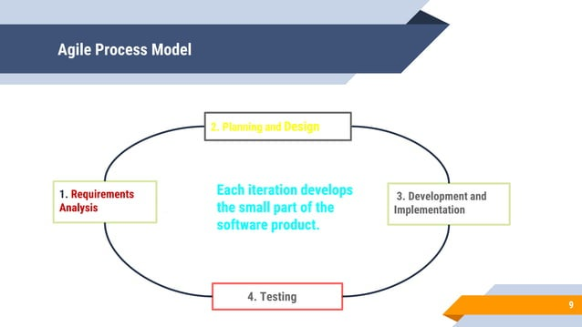

Slide 12
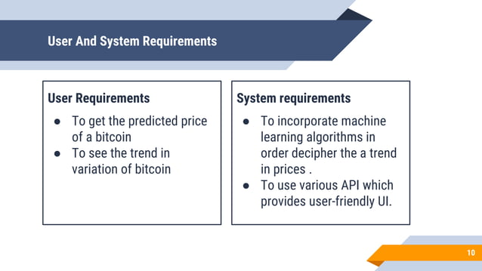

Slide 13
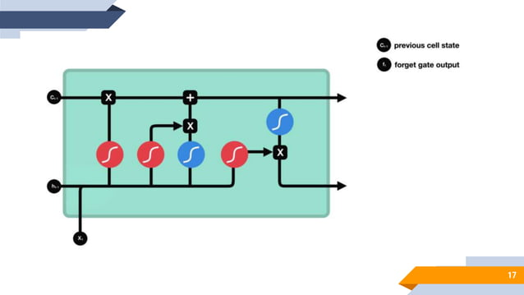
Design the model

Slide 14
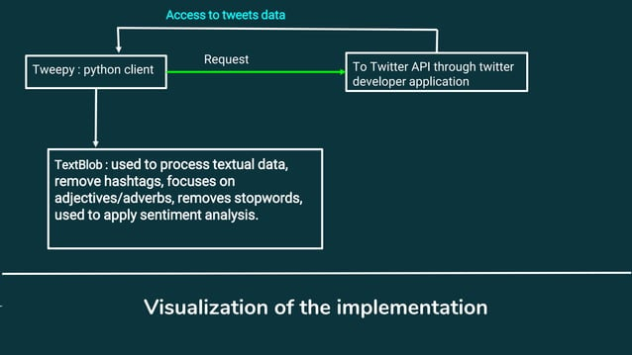
Implementation

Slide 15
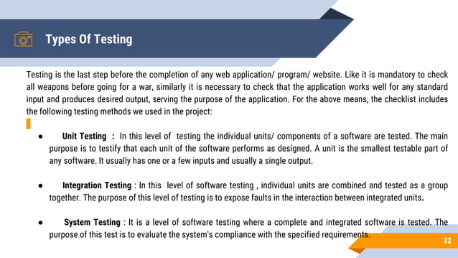
Testing

Slide 16
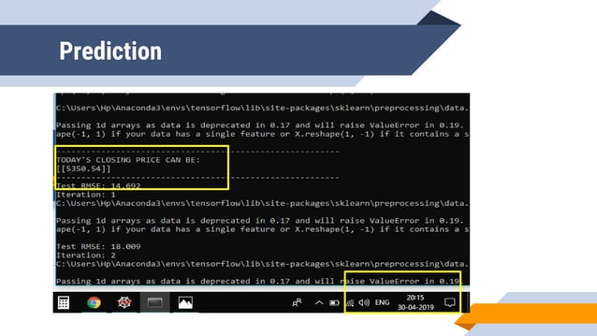

Slide 17
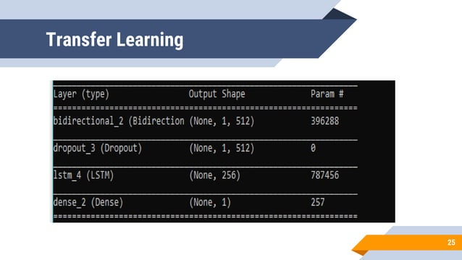

Slide 18
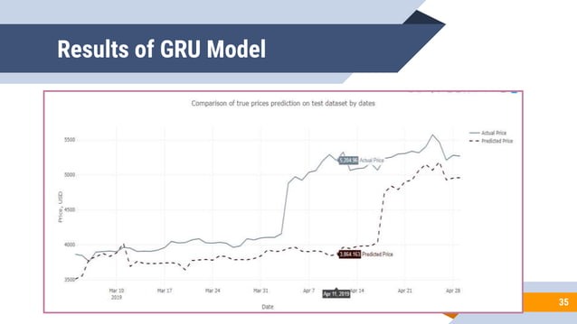

Slide 19
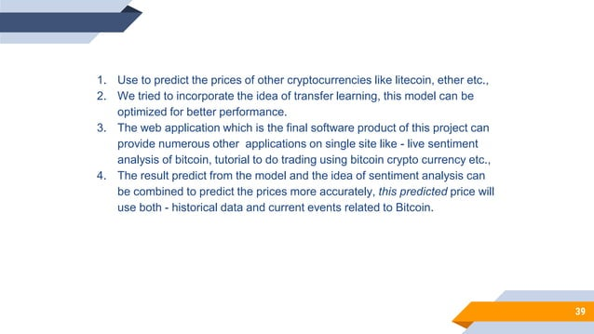
Future scopes

